Slide 1
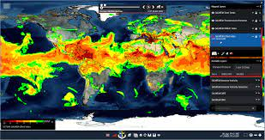
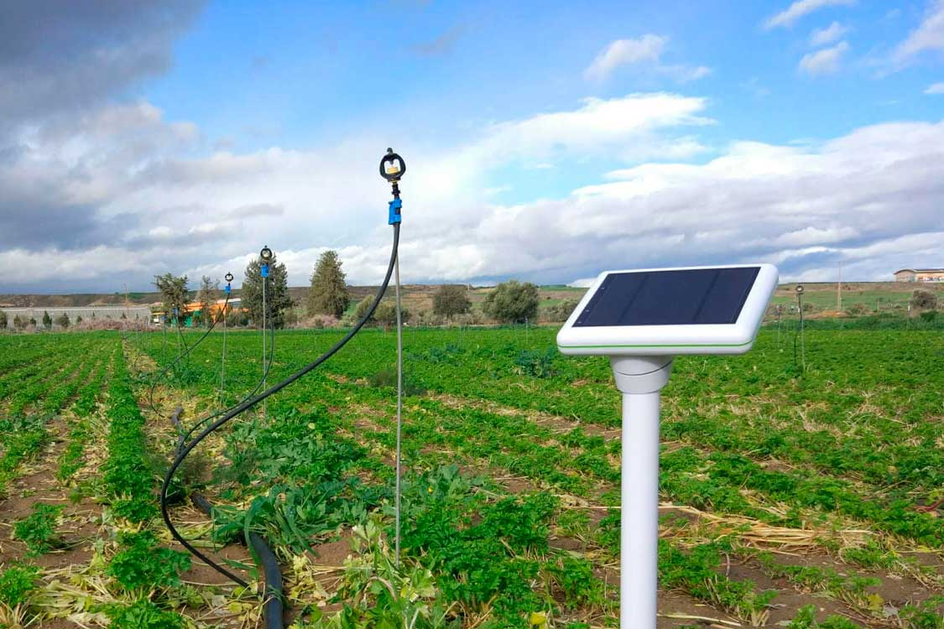
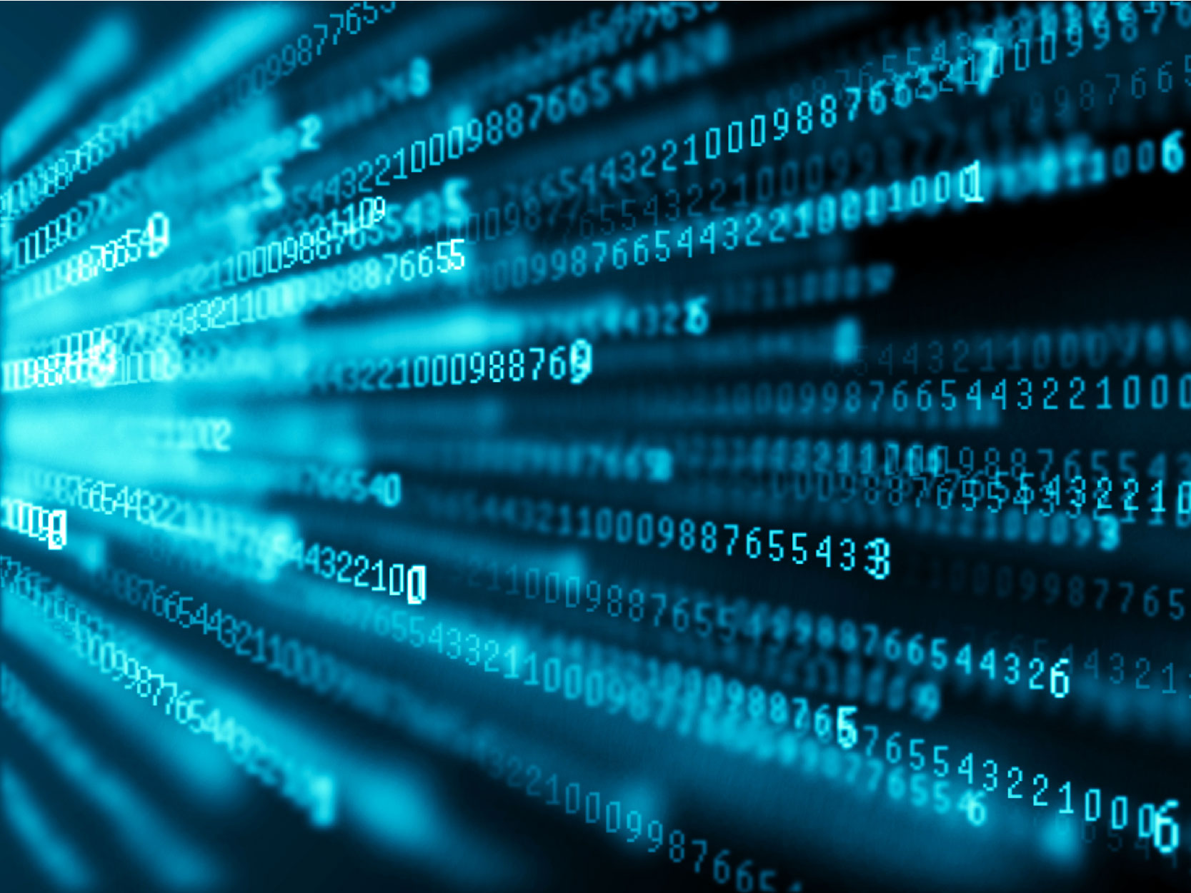




An Example of an end-to-end Application Data Architecture
Smart Farming use case – IoT in Agriculture
External Data Source:
Open Weather Data
Messaging system
App Server - Apache
DB Server – SQL
pull
Source1
Source 2
App Cache
Thousands of weather sensors: collect various data from the environment and send it to the cloud
push
Data Analytics
Real-time Data Streams over Internet
Precision Farming App: Uses provided measurements to map climate conditions, choose the appropriate crops, and take the required measures to improve capacity
Agriculture Fields
Data Centers
Data Analytics across different data sources
Data Acquisition
Data Ingestion and Streaming
Data Processing
Data Analytics
Created and maintained by hamadeh@
https://github.com/hassanhamade/tanzudataservices

Slide 2
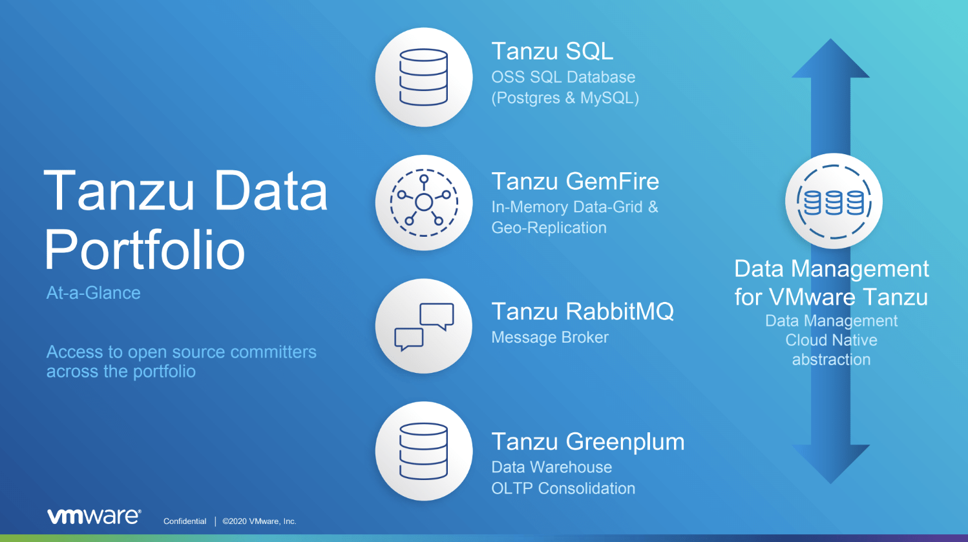

Slide 3


Data at Any Speed
Tanzu Data Product Portfolio
In Flight
Just Perching
At Rest
In Analysis
RabbitMQ | GemFire | Postgres | Greenplum
Message Broker | In-Memory Data Grid | Relational Database | Scale-out Analytical DB
Asynchronous message or event integrations between applications or services | Caching Complex Event Processing | Transactional application backends | BI/MI reporting In-database analytics Spatial Text ML Deep Learning
Notes:
Logos are from underlying OSS, since all Tanzu logos are now the same

Slide 4

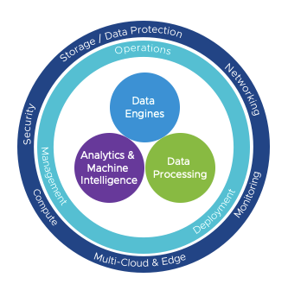
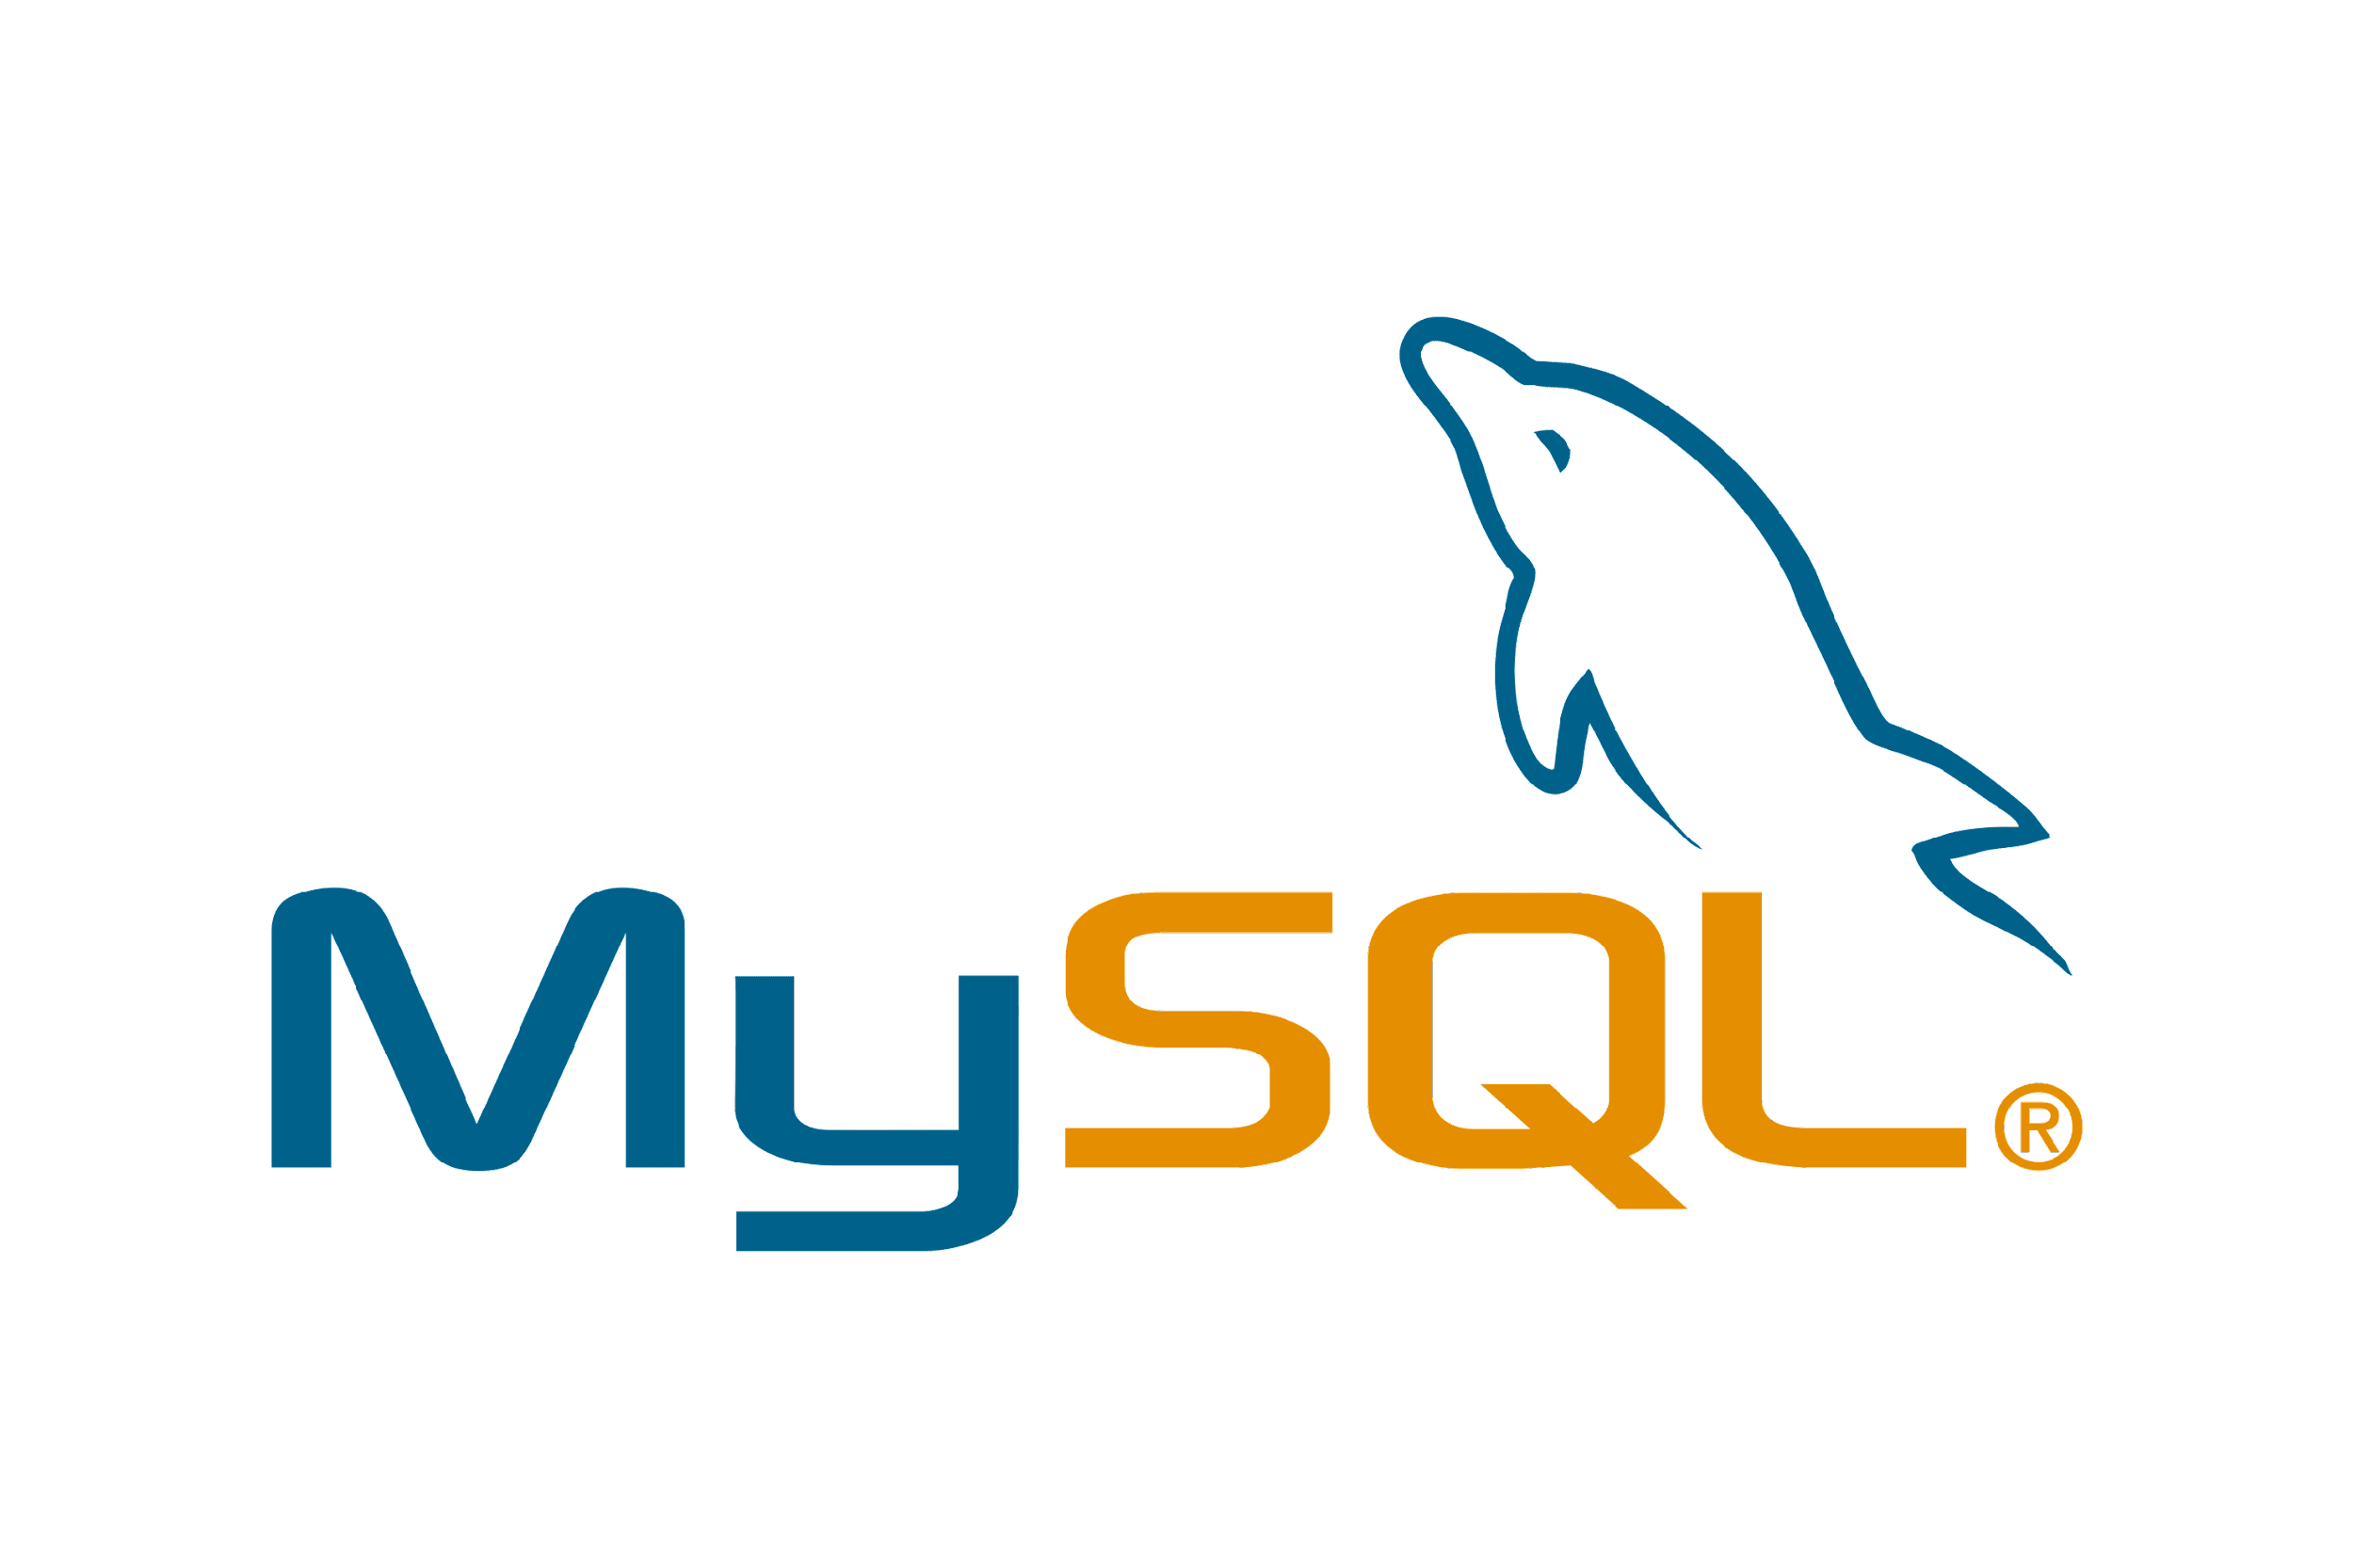
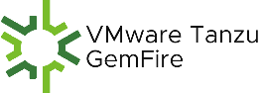

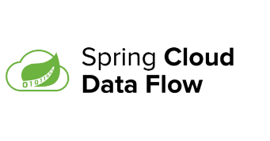


Data Market Landscape – VMware Has a Significant Presence
Relational Database
Non Relational Database
Data Warehouse
Data
Engines
ETL / ELT
Data Lake
Real Time Data Integration / CDC
Data Management
Analytics &
Machine
Intelligence
Data
Processing
Data Preparation & Quality
Data Federation & Virtualization
Data Quality & Preparation
Stream Processing Software
Explainable AI
Messaging Middleware
Modeling & Monitoring
Machine Learning
Notes:
Data Science:
Money under data science is more in the data quality/prep and modeling and monitoring side.
ML and AI is cool but the tech is hard
Data cleaning and prep is boring but like in a gold rush: "sell shovels"

